Slide 1


Early detection of DDoS and prevention using centralized SDN Controller
Group 15
Jagan Mohan Reddy Peddabavi
Class id 30

Slide 2
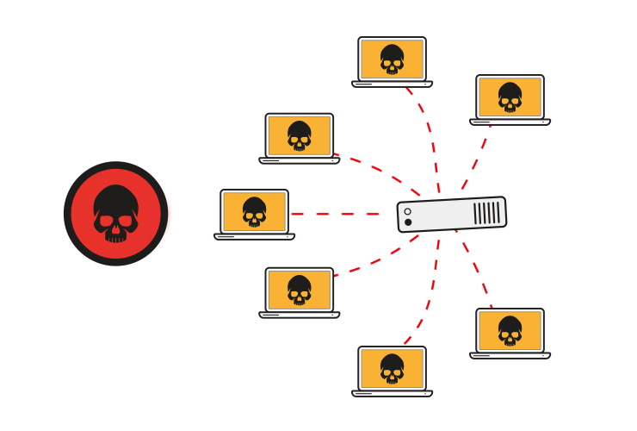
What is a DDoS attack?
Basically, large number of packets are forwarded to a network device for stopping the service, decreasing the performance and spoofed packets sent to controller.

Slide 3
POX CONTROLLER MODULES
pox.openflow.discovery:
sends specially-crafted LLDP messages out of OpenFlow switches so that it can discover the network topology
pox.host_tracker:
attempts to keep track of hosts in the network. Host Tracker examines messages received by POX and learns MAC and IP of hosts in the network
pox.flatfile_record.switch_aggports_ffrecord:
forwarding module for enabling communication among hosts and switches in a network

Slide 4
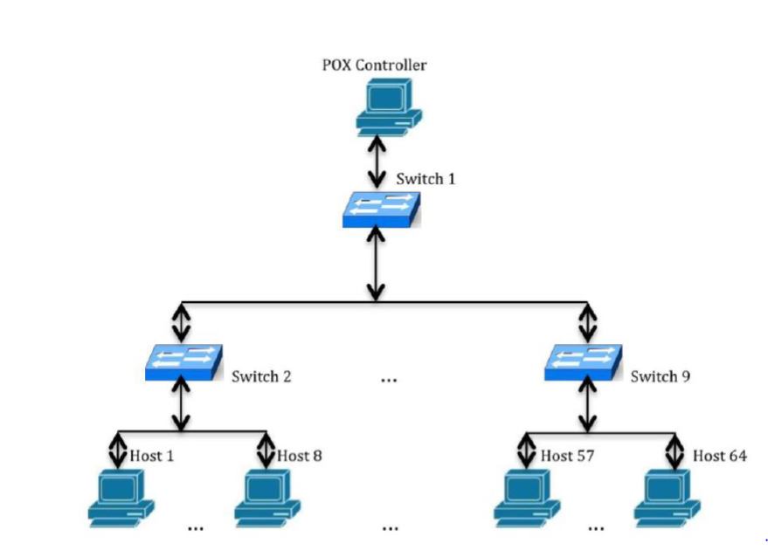
TOPOLOGY IN MININET

Slide 5
Packet generation
Scapy
Scapy is a powerful interactive packet manipulation program. It is able to decode packets of a wide variety of protocols, send them on the network, simulate attacks, capture packets, match request and replies and much more.
In Mininet, the IP addresses are assigned incrementally starting from 10.0.0.1. For the normal traffic, the destination address is generated based on the range specified in the script (example – 10.0.0.1 to 10.0.0.64). The source IP addresses are generated using a random function ‘randrange(1,256)’.
Popen
The popen() function executes the specified command. It creates a pipe between the calling program and the executed command, and returns a pointer to a stream that can be used to either read from or write to the pipe.

Slide 6
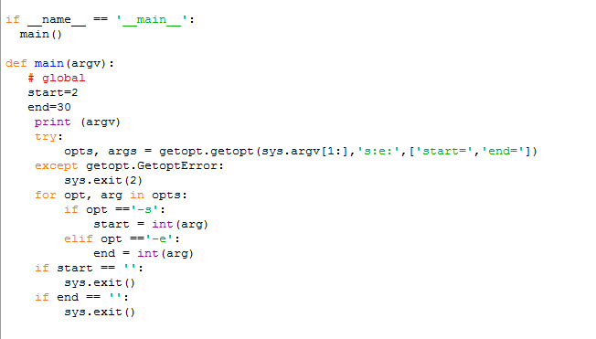
If the script is being imported into another module, its various function and class definitions will be imported and its top-level code will be executed, but the code in the then-body of the if clause won’t run as the condition is not met.

Slide 7
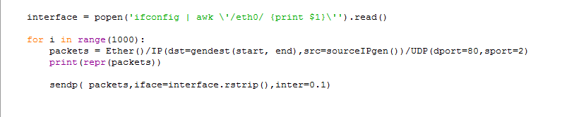
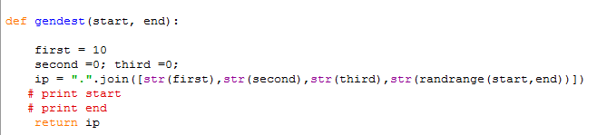
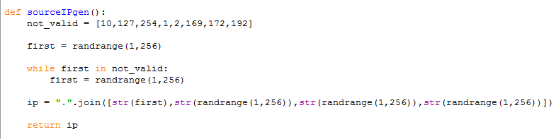

Slide 8
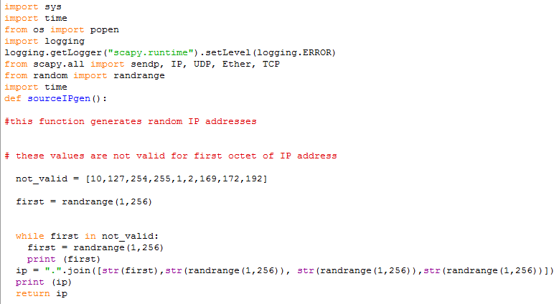
Launch attack code

Slide 9
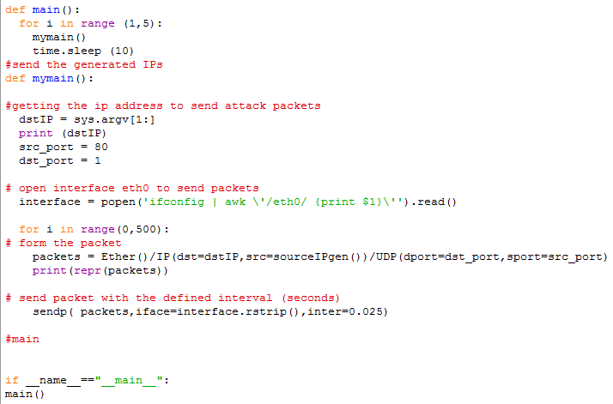

Slide 10
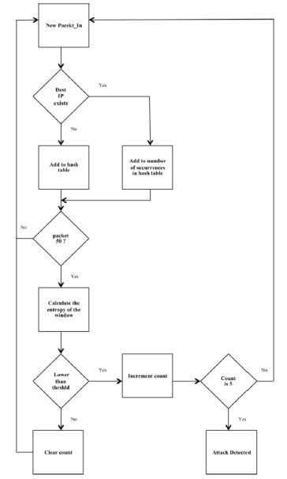

Slide 11
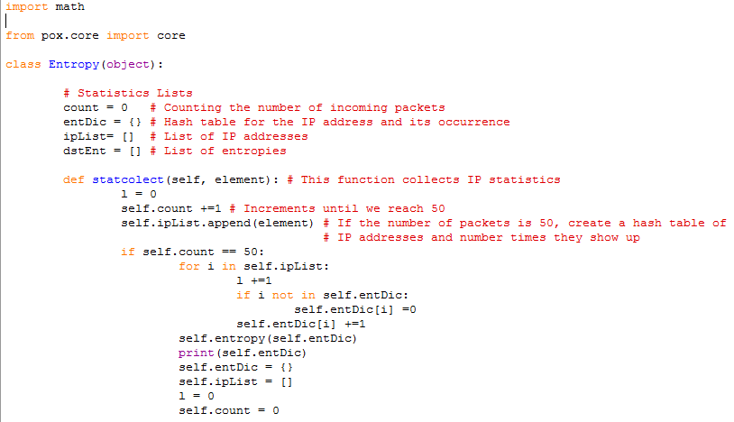
DETECTION CODE
POX has an object called ‘core’, which serves as a central point for much of POX's API.
The core object provides connections between components.
Often, rather than using import statements to have one component import another component so that they can interact, components will instead ‘register’ themselves on the core object, and other components will query the core object.

Slide 12
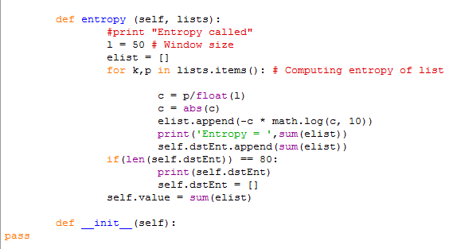

Slide 13
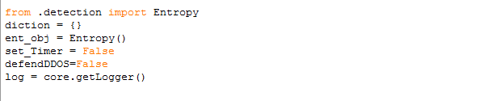
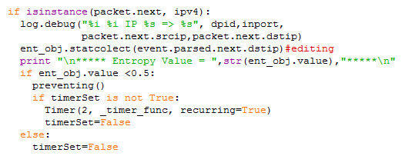
Pox Layer-3 editing
Here, we are importing the entropy function from the detection code.
Then, we are checking for the threshold value.
If the entropy value is less than 0.5, then we will use preventing function of pox to detect whether DDoS attack occurred or not.

Slide 14
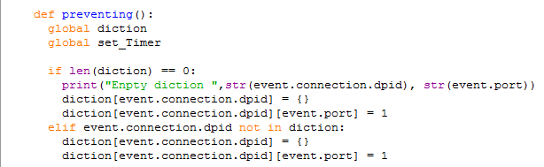
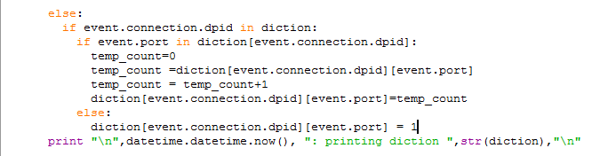
Pox Layer-3 functions
Here, we are looking for a dictionary which contains switch ID and port number.
The ID of the switch/router which got up can be retrieved by:
event.connection.dpid
The IDs are normally assigned in the order of devices coming up starting from 1 to the number of devices present.

Slide 15
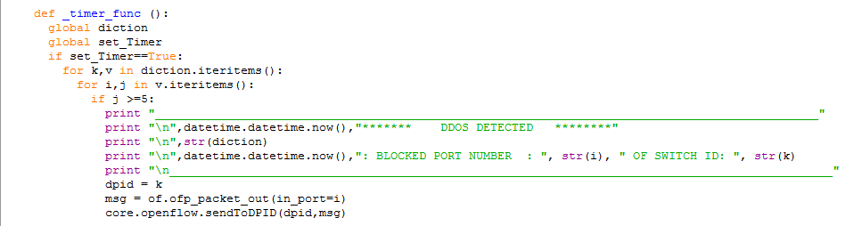
Pox Layer-3 functions
Here, we are using timer_func function of pox to detect DDoS.
We are examining the dictionary and DDoS will be detected if the count value is greater than 5.
msg = of.ofp_packet_out(in_port=i)
core.openflow.sendToDPID(dpid,msg)
The controller sends the packet_out message to the destination.

Slide 16
results

Slide 17
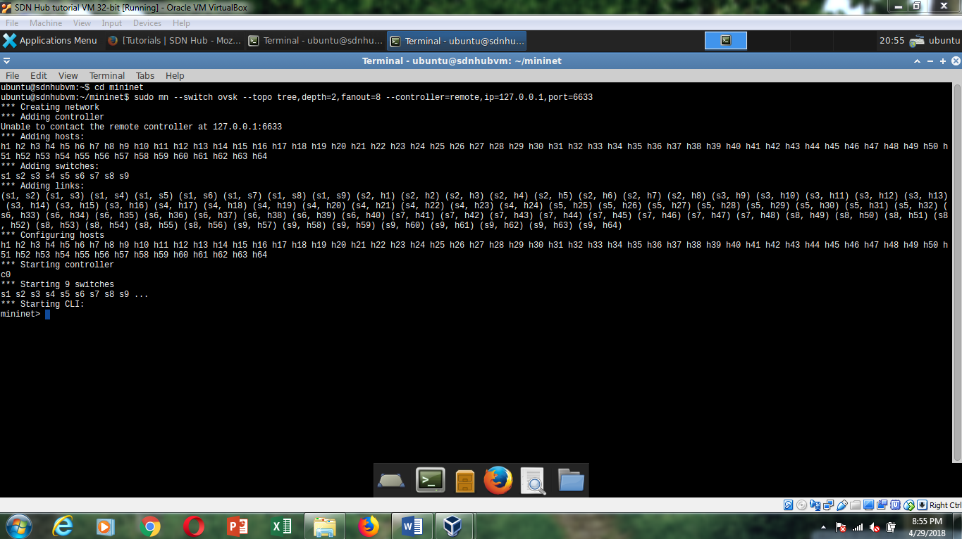
Creating topology in mininet

Slide 18
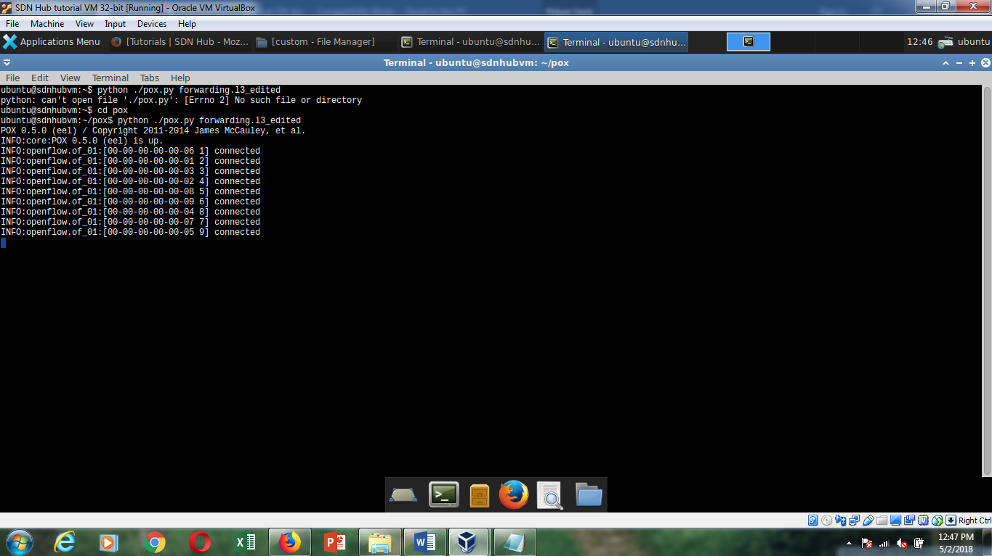
Starting pox controller

Slide 19
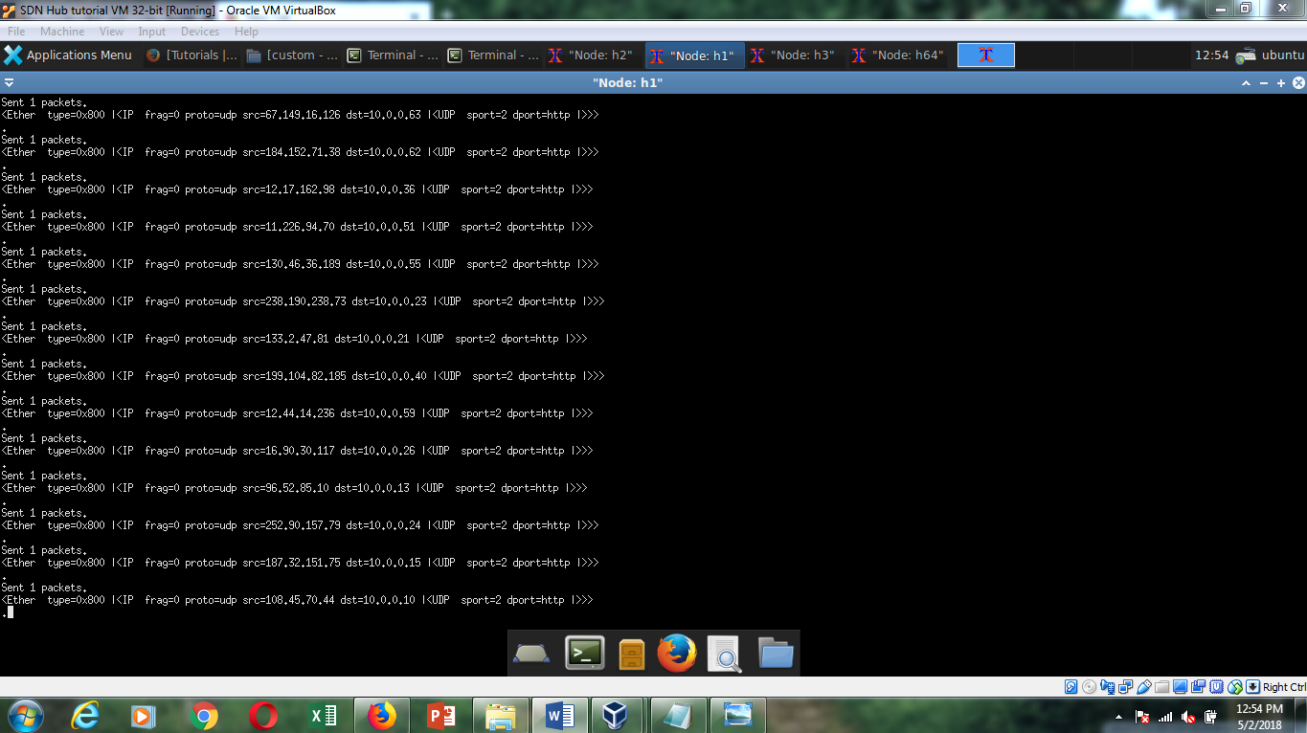
Traffic launch

Slide 20
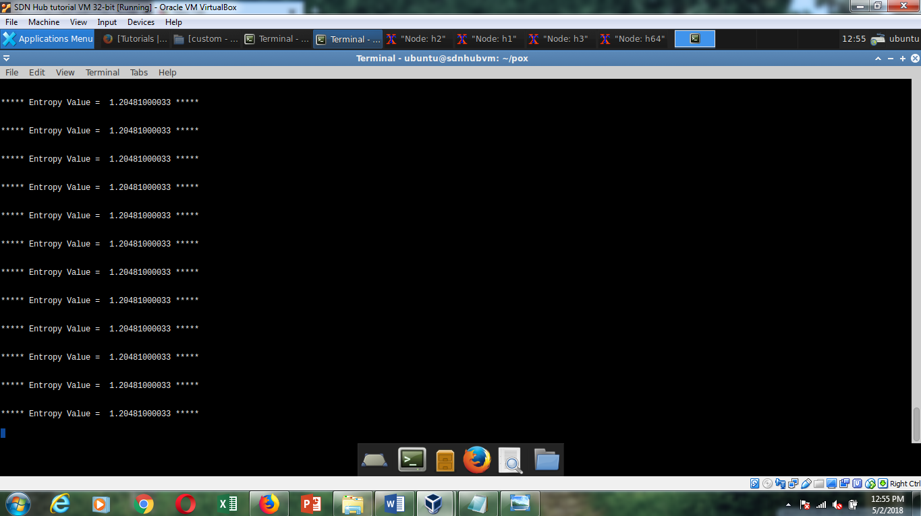
Entropy value before ddos attack

Slide 21
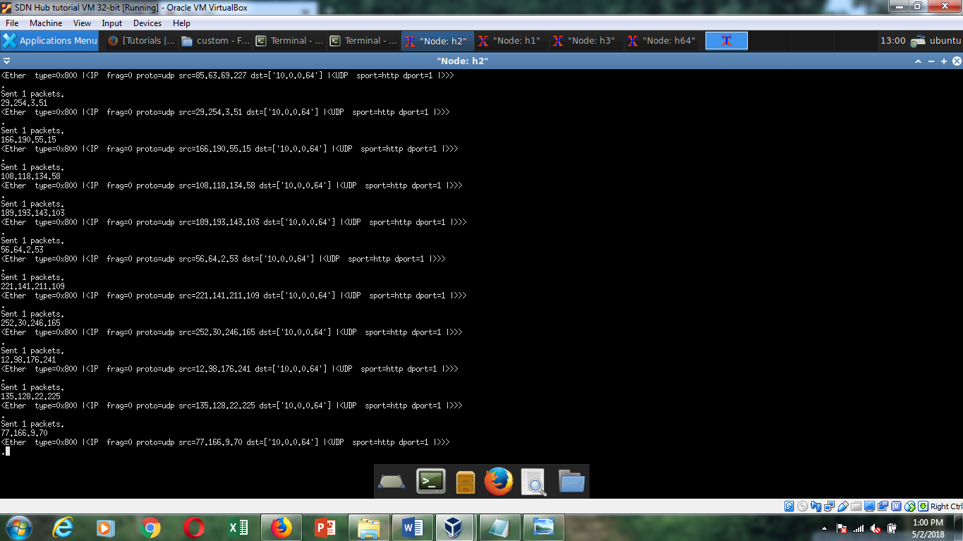
Launch attack

Slide 22
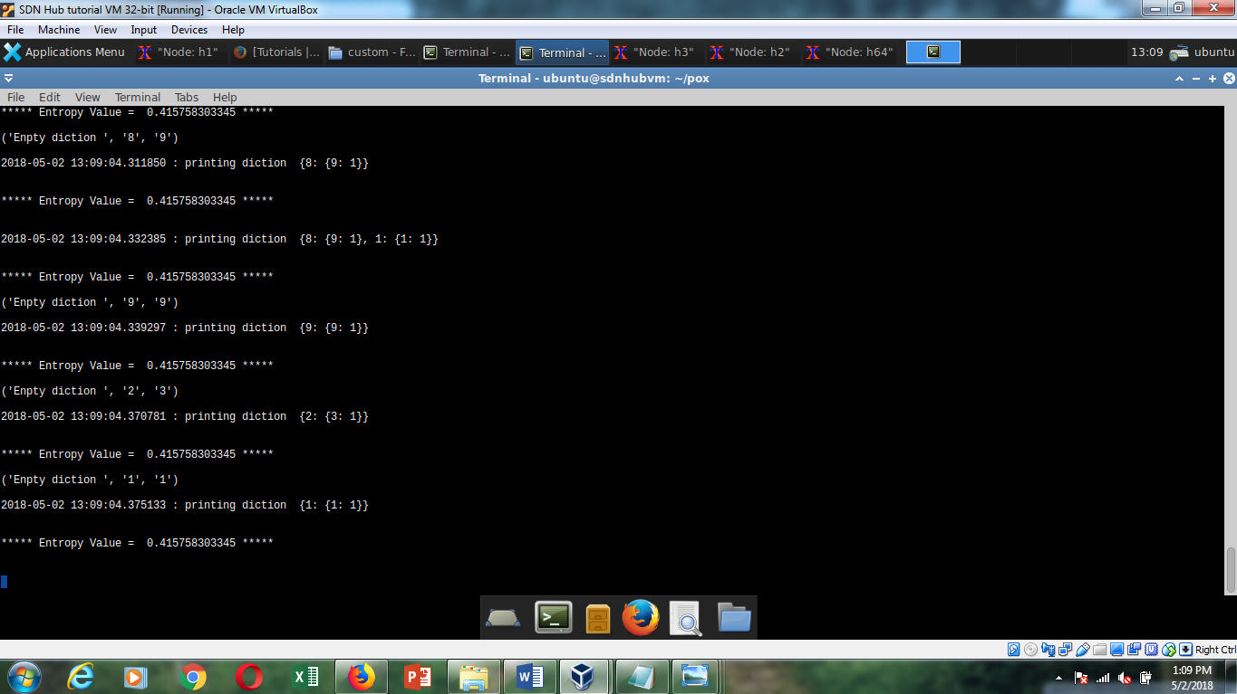
Entropy value after ddos attack

Slide 23
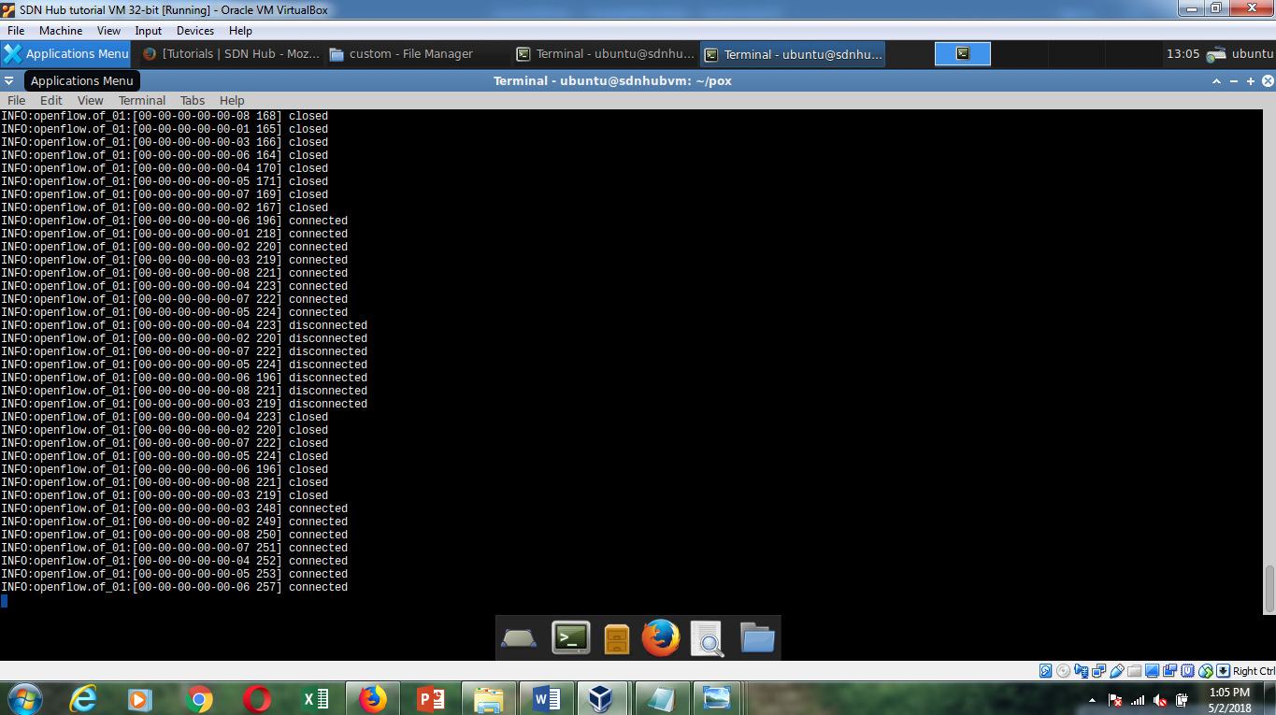
Switches starting again after ddos attack

Slide 24
THANK YOU

